Slide 1

Project 3
Team 4
NFT Market place

Slide 2
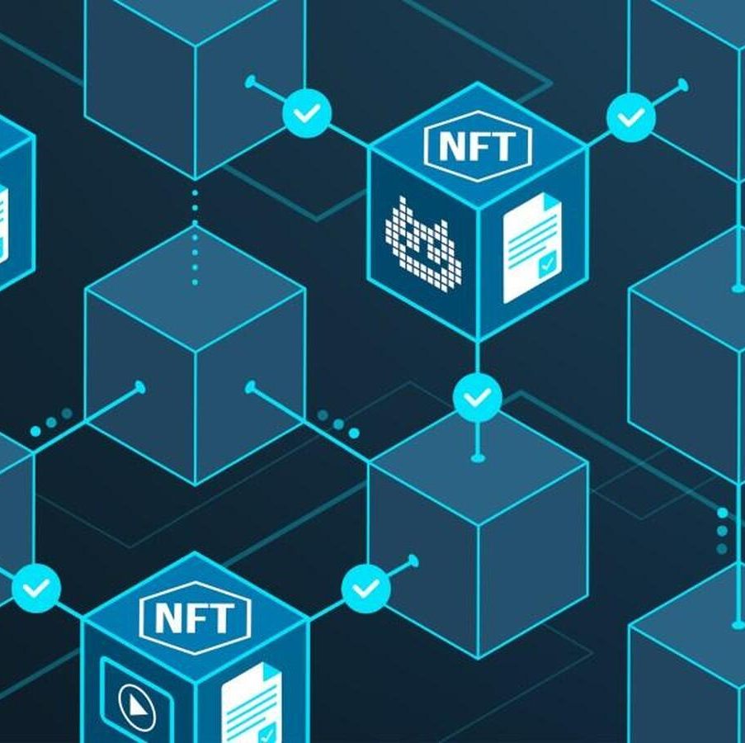
NFT Talks

Slide 3
NFT Auction Platform
Smart Contract built in Solidity
Bidder with MetaMask wallet can participate
Highest bidder is recorded
ART Auction
list the Address of the Art Content in Pinata.
Connect the Blockchain with AWS server.

Slide 4



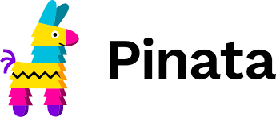
Data Preparation: Solidity and Remix
Create smart contract
Run on remix
Executed in solidity smart contract
list the Art in Pinata

Slide 5

Process Flow
Smart contract: Import more libraries with AWS
Connect to the blockchain smart contract
Slack
Discord
IPFS
Pinata

Slide 6

Auction Screen shots
* https://blog.quantinsti.com/vader-sentiment/

Slide 7
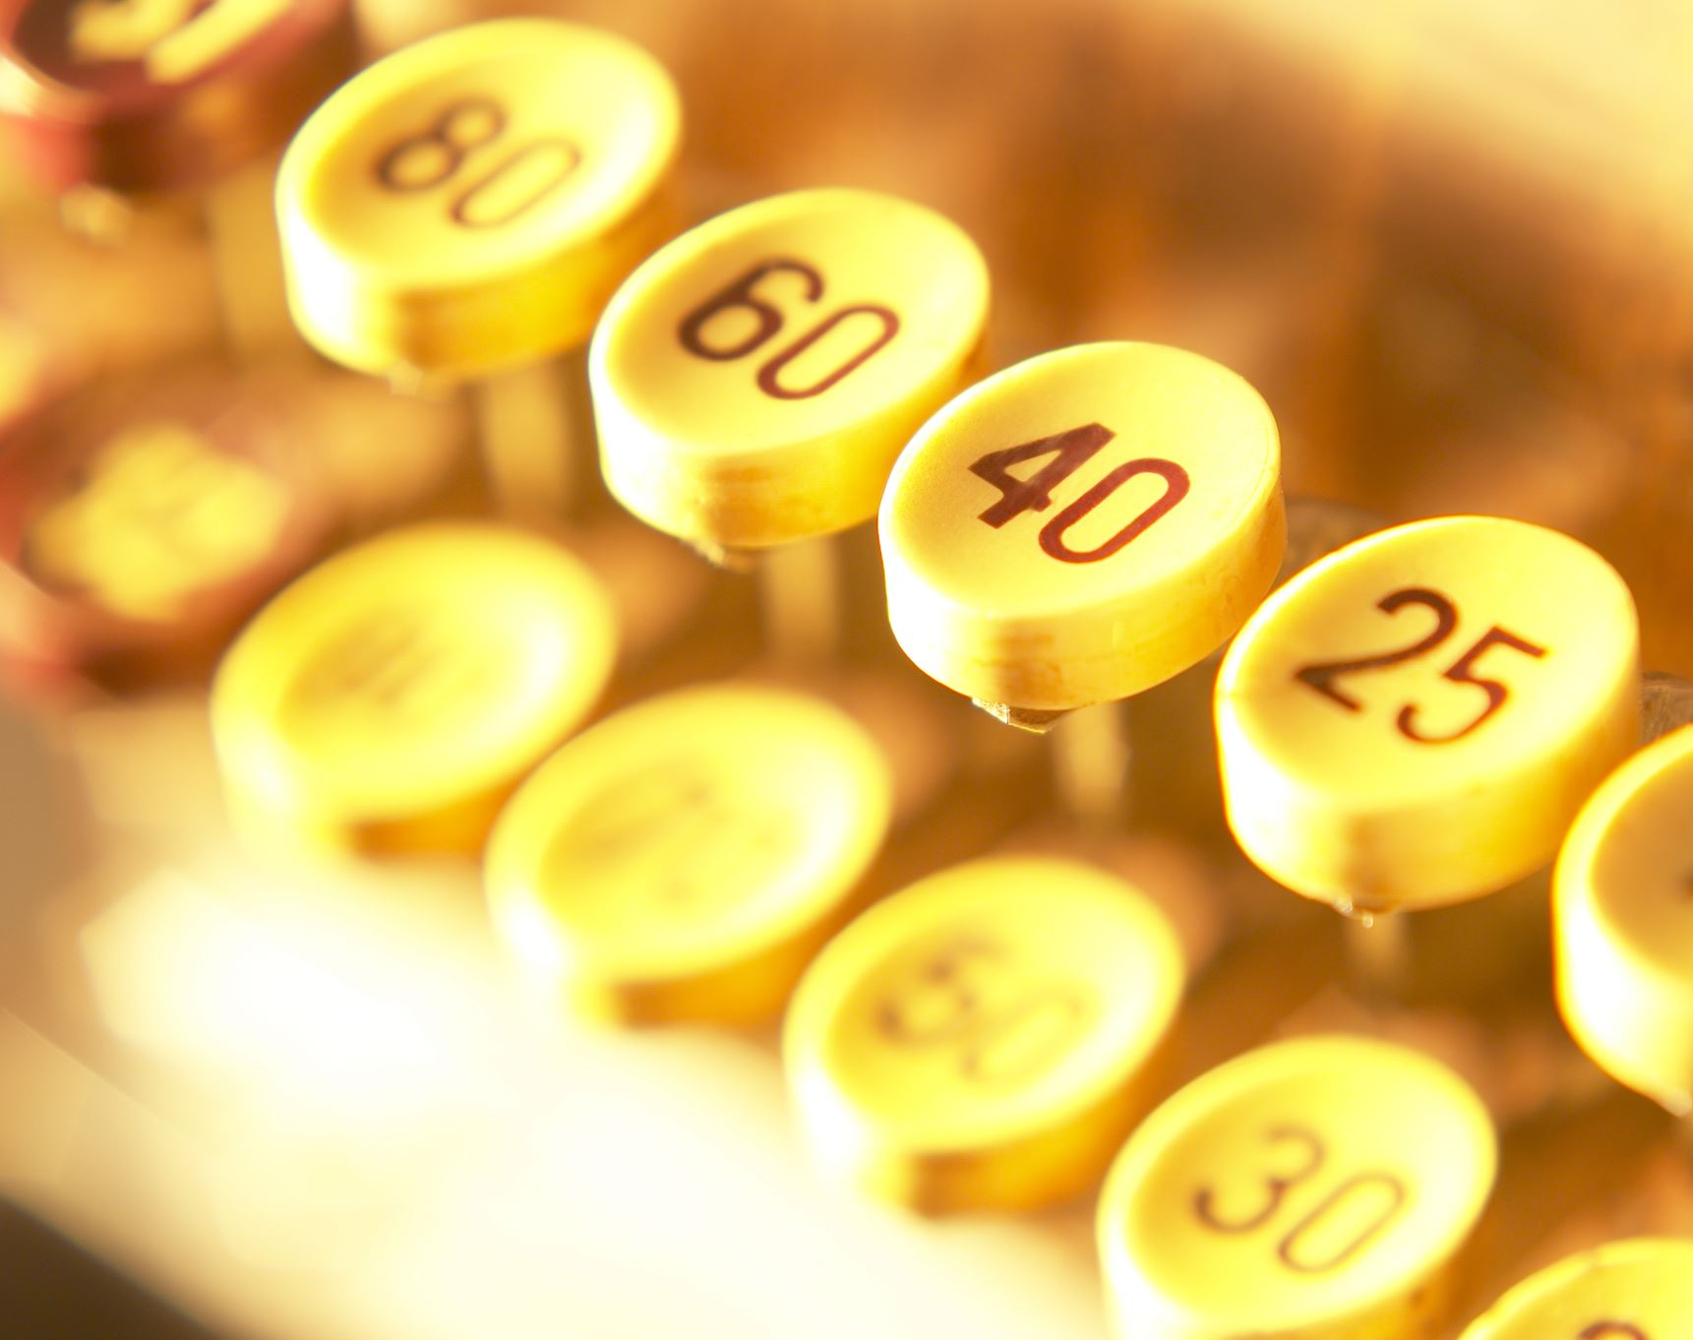
Wallet Address

Slide 8

Art Royalty
Revenue structure
Artis Royalty 3% to 12%
Profit percentage 3% up to 20% profit.
7.5% up to 50% Profit.
12% up to 100% and over

Slide 9
Functions: Front End
Build
Smart Contact
Define
Test the transaction
Import
Remix and solidity
APIs
Evaluate
Pinata
AWS server
Return
Tokenized 721 NFT
smart contract executed

Slide 10
NON-FUNGIBLE

Slide 11

Final Conclusions & Challenges
Additional library dependencies required?
List user external

